Slide 1

Presentation on
Unsupervised Face Clustering by Using Machine Learning
Of
BACHELOR OF ENGINEERING
IN
COMMUTER SCIENCE AND ENGINEERING
By
ABHAY KUMAR AWASTHI
Under the Guidence of
Prof. Dr. B.D.K Patro
Department of Computer Science And Engineering
Rajkiya Engineering College , Kannauj
1
NAME OF THE INSTITUTE, PARUL UNIVERSITY

Slide 2
Broad Outline
Abstract
Problem Statement
Proposed Solution
Goal & Objective
Introduction
Algorithm Used
Literature Survey
Conclusion
References
Rajkiya Engineering College , Kannauj
2
NAME OF THE INSTITUTE, PARUL UNIVERSITY
,

Slide 3
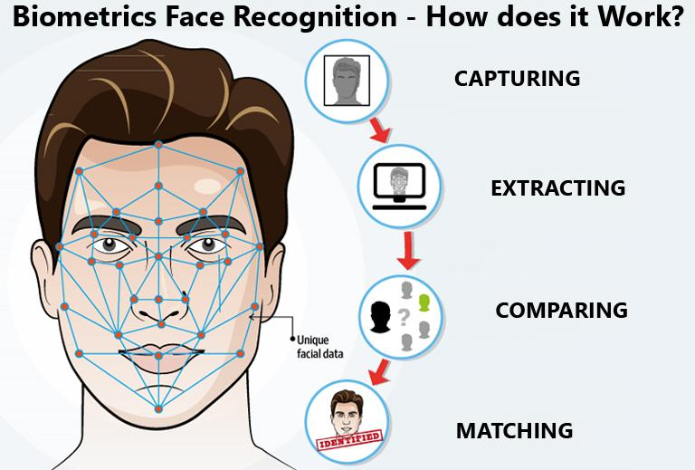
Abstract
The utilization of unsupervised learning techniques in facial recognition has gained significant attention due to its potential in various applications ranging from surveillance systems to social media analytics. This presents a detailed examination of a machine learning-based unsupervised face clustering pipeline.
3
Rajkiya Engineering College , Kannauj
NAME OF THE INSTITUTE, PARUL UNIVERSITY

Slide 4
Abstract
This begins by providing an overview of the key concepts involved in unsupervised learning and face clustering. It then delves into the specifics of the pipeline architecture outlined in the referenced article, elucidating each step from data preprocessing to clustering algorithms such as DBSCAN (Density-Based Spatial Clustering of Applications with Noise) and K-Means.
Discusses the challenges encountered in unsupervised face clustering, including variations in illumination, pose, and expression, along with potential solutions proposed in the pipeline. It also addresses the performance metrics used to evaluate the efficacy of the clustering algorithm, such as precision, recall, and F1-score.Moreover, practical considerations regarding the deployment and scalability of the pipeline are examined, along with possible extensions and future research directions . Additionally, the report discusses the limitations of the proposed approach and suggests areas for improvement.
4
Rajkiya Engineering College , Kannauj
NAME OF THE INSTITUTE, PARUL UNIVERSITY

Slide 5
Problem Statement
Live face-recognition is a problem that automated security division still face. With the advancements in Convolutions Neural Networks and specifically creative ways of Region-CNN, it’s already confirmed that with our current technologies, we can opt for supervised learning options such as FaceNet, YOLO for fast and live face recognition in a real-world environment.
To train a supervised model, we need to get datasets of our target labels which is still a tedious task. We need an efficient and automated solution for the dataset generation with minimal labeling effort by user intervention robust, efficient, and versatile facial recognition systems tailored to meet the evolving needs of diverse domains..
5
Rajkiya Engineering College , Kannauj
NAME OF THE INSTITUTE, PARUL UNIVERSITY

Slide 6
Proposed Solution
We are proposing a dataset generation pipeline which takes a video clip as source and extracts all the faces and clusters them to limited and accurate sets of images representing a distinct person. Each set can easily be labeled by human input with ease.
6
Rajkiya Engineering College , Kannauj
NAME OF THE INSTITUTE, PARUL UNIVERSITY

Slide 7
Goal & Objective
The primary objective of this project is to implement and evaluate the effectiveness of the machine learning-based unsupervised face clustering pipeline
Specifically ,the project aim to : 1. Understand the theoretical concepts behind unsupervised face clustering and the pipeline architecture proposed in the article. 2. Implement the pipeline using appropriate programming languages and libraries. 3. Evaluate the performance of the pipeline on a dataset of face images. 4. Explore potential modifications or enhancements to the pipeline to improve its effectiveness or efficiency. 5. Analyze the results obtained from the face clustering process and draw conclusions regarding its applicability and limitations
7
Rajkiya Engineering College , Kannauj
NAME OF THE INSTITUTE, PARUL UNIVERSITY

Slide 8
Goal & Objective
The scope of this project encompasses the following key aspects:
1.Implementation of Pipeline:
The project will involve the implementation of the entire face clustering pipeline, including data preprocessing, feature extraction, clustering algo- rithms, and evaluation metrics. 2. Dataset Selection:
A suitable dataset containing face images will be selected for experimentation and evaluation of the pipeline. The dataset may be sourced from publicly available repositories or custom collections. 3. Evaluation and Analysis:
The performance of the pipeline will be evaluated using established metrics such as precision, recall, and F1-score. Additionally, qualitative analysis of the clustered results will be conducted to assess the pipeline’s effectiveness in grouping similar faces. 4 . Modifications and Extensions:
Depending on the project timeline and resources, potential modifications or extensions to the pipeline may be explored. This could include experimenting with different clustering algorithms, incorporating additional feature extraction techniques, or optimizing the pipeline for scalability.
8
Rajkiya Engineering College , Kannauj
NAME OF THE INSTITUTE, PARUL UNIVERSITY

Slide 9
Goal & Objective
5. Documentation and Reporting:
Throughout the project, detailed documentation will be maintained, covering aspects such as implementation steps, experimental setup, results, and analysis. A final report will be prepared, summarizing the findings and insights gained from the project. 6. Limitations:
It’s important to acknowledge the limitations of the project,Including constraints related to computational resources, time, and the complexity of the face clustering task. The project will focus on a specific subset of unsupervised face clustering techniques and may not cover all possible variations or scenarios.
9
Rajkiya Engineering College , Kannauj
NAME OF THE INSTITUTE, PARUL UNIVERSITY

Slide 10
Introduction
• Facial recognition technology has witnessed remarkable advancements in re- cent years, revolutionizing various sectors including security, marketing, and human-computer interaction. Among the myriad approaches to facial recogni- tion, unsupervised face clustering stands out as a promising technique, offering the capability to organize and categorize faces without the need for labeled training data.
• This report delves into a comprehensive analysis of a machine learning-based unsupervised face clustering pipeline, as outlined in the article ”ML Unsu- pervised Face Clustering Pipeline”. With the increasing demand for effi- cient and scalable facial recognition systems, understanding the intricacies of such pipelines becomes imperative for researchers, engineers, and practitioners alike.
• In this introduction, we provide a brief overview of the significance of unsu- pervised face clustering, highlighting its relevance in real-world applications. We also outline the objectives and scope of this report, setting the stage for a detailed exploration of the pipeline architecture, challenges, performance evaluation metrics, practical considerations, and avenues for future research.
• By unraveling the underlying mechanisms of unsupervised face clustering and critically evaluating the proposed pipeline, this report aims to equip readers with a deeper understanding of the intricacies involved in harnessing machine learning for facial recognition tasks. Furthermore, insights gleaned from this analysis can inform the development of more robust, efficient, and versatile facial recognition systems tailored to meet the evolving needs of diverse do- mains.
10
Rajkiya Engineering College , Kannauj
NAME OF THE INSTITUTE, PARUL UNIVERSITY

Slide 11

Input
11
Rajkiya Engineering College , Kannauj
NAME OF THE INSTITUTE, PARUL UNIVERSITY

Slide 12
Algorithm Used
1. DBSCAN (Density-Based Spatial Clustering of Applications with Noise): (a) DBSCAN is a density-based clustering algorithm that groups together points that are closely packed, separating regions of high density from regions of low density. (b) It does not require a predefined number of clusters and is robust to noise and outliers. (c) Parameters such as epsilon (eps) and minimum samples (min-samples) need to be configured appropriately to achieve satisfactory clustering results.
12
Rajkiya Engineering College , Kannauj
NAME OF THE INSTITUTE, PARUL UNIVERSITY

Slide 13
Algorithm Used
K-Means: (a) K-Means is a centroid-based clustering algorithm that partitions the data into ’k’ clusters based on the mean distance of points to the cluster centroids. (b) It requires specifying the number of clusters ’k’ beforehand and is sen- sitive to the initial choice of cluster centroids. (c) Despite its simplicity, K-Means is widely used and can be effective for certain types of datasets.
13
Rajkiya Engineering College , Kannauj
NAME OF THE INSTITUTE, PARUL UNIVERSITY

Slide 14
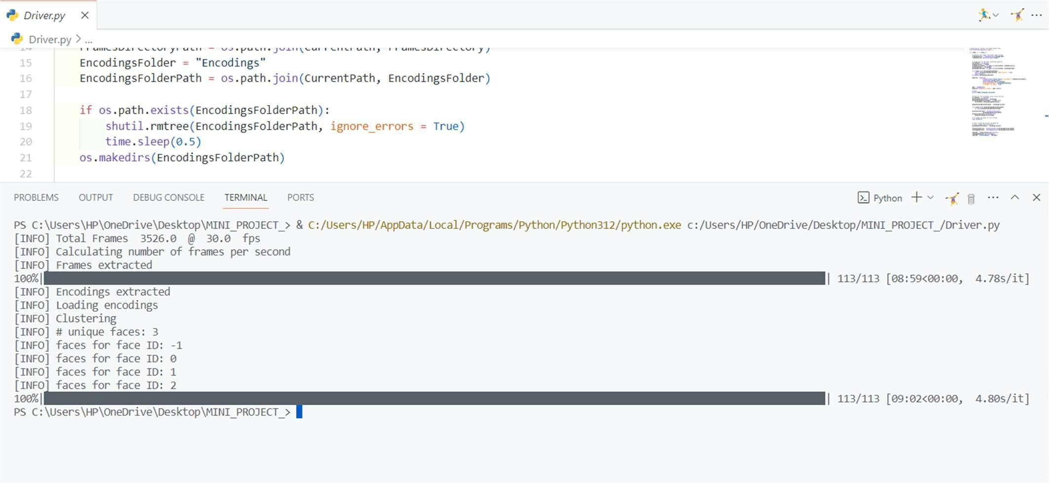
Output
14
Rajkiya Engineering College , Kannauj
NAME OF THE INSTITUTE, PARUL UNIVERSITY

Slide 15

Output
Rajkiya Engineering College , Kannauj
15
NAME OF THE INSTITUTE, PARUL UNIVERSITY

Slide 16
My Work
My primary contribution was the integration of live video streaming function- ality to replace the conventional method of taking recordings for face cluster- ing. This enhancement aimed to facilitate real-time face clustering, allowing for dynamic and continuous analysis of faces captured through a camera feed. The conventional approach involved processing pre-recorded video footage, which limited the applicability of the pipeline to offline scenarios or scenarios with pre-existing video recordings. Recognizing the need for real-time analysis in various applications such as surveillance systems, interactive installations, and live event monitoring, I implemented a solution
16
Rajkiya Engineering College , Kannauj
NAME OF THE INSTITUTE, PARUL UNIVERSITY

Slide 17
My Work
Camera Interface Integration:I incorporated functionality to interface with a camera device, enabling the pipeline to capture live video frames directly.
Real-Time Frame Processing: Upon capturing each frame from the live video feed, I implemented realtime processing to extract facial features and perform clustering without the need for intermediate video storage.
Visualization and Feedback: To provide immediate feedback, I in- tegrated visualization components to display the live video feed along with annotated clusters in real-time, facilitating interactive monitoring and analysis.
Optimization for Performance: Given the computational demands of real-time processing, I optimized the implementation to ensure efficient utilization of computational resources, balancing performance with accu- racy.
17
Rajkiya Engineering College , Kannauj
NAME OF THE INSTITUTE, PARUL UNIVERSITY

Slide 18
Conclusion
1. Pipeline Implementation: The project successfully implemented the un- supervised face clustering pipeline, encompassing data preprocessing, feature extraction, clustering algorithms, evaluation metrics, and visualization com- ponents. Leveraging OpenCV for image processing tasks and scikit-learn for machine learning functionalities enabled a comprehensive and efficient imple- mentation. 2. Algorithm Understanding: The project demonstrated a deep understand- ing of clustering algorithms, particularly DBSCAN and K-Means. Detailed explanations of the algorithms’ principles, parameters, advantages, and disad- vantages were provided, aiding in the selection and configuration of suitable algorithms for the face clustering task. 3. Evaluation and Analysis: The performance of the implemented pipeline was thoroughly evaluated using established metrics such as precision, recall, and F1-score. Qualitative analysis of the clustered results provided insights into the effectiveness of the clustering algorithms in grouping similar faces and the interpretability of the clustering output.
18
Rajkiya Engineering College , Kannauj
NAME OF THE INSTITUTE, PARUL UNIVERSITY

Slide 19
References
1. GeeksforGeeks. ML — Unsupervised Face Clustering Pipeline - Geeks- forGeeks. Available online: https://www.geeksforgeeks.org/ml-unsupervised- face-clustering-pipeline/ 2. OpenCV. Open Source Computer Vision Library. Available online: https://opencv.o 3. scikit-learn. Machine Learning in Python. Available online: https://scikit- learn.org/stable/ 4. NumPy. The fundamental package for scientific computing with Python. Available online: https://numpy.org/ 5. Matplotlib. Python plotting library. Available online: https://matplotlib.org/ 6. Ester, M., Kriegel, H. P., Sander, J., & Xu, X. (1996). A density-based algorithm for discovering clusters in large spatial databases with noise. In KDD-96 Proceedings (Vol. 96, No. 34, pp. 226-231). 7. MacQueen, J. B. (1967). Some methods for classification and analysis of multivariate observations. In Proceedings of the fifth Berkeley symposium on mathematical statistics and probability (Vol. 1, No. 14, pp. 281-297). 8. Milligan, G. W., & Cooper, M. C. (1985). An examination of procedures for determining the number of clusters in a data set. Psychometrika, 50(2), 159-179. 9. Pan, S. J., Tsang, I. W., Kwok, J. T., & Yang, Q. (2010). Domain adap- tation via transfer component analysis. IEEE Transactions on Neural Networks, 22(2), 199-210. 10. Caron, M., Bojanowski, P., Joulin, A., & Douze, M. (2018). Deep cluster- ing for unsupervised learning of visual features. In European conference on computer vision (pp. 132-149). Springer, Cham.
Rajkiya Engineering College , Kannauj
19
NAME OF THE INSTITUTE, PARUL UNIVERSITY

Slide 20
References
11. Ng, A. Y., Jordan, M. I., & Weiss, Y. (2002). On spectral clustering: Analysis and an algorithm. In Advances in neural information processing systems (pp. 849-856). 12. Kingma, D. P., & Welling, M. (2014). Auto-encoding variational bayes. arXiv preprint arXiv:1312.6114.
Rajkiya Engineering College , Kannauj
20
NAME OF THE INSTITUTE, PARUL UNIVERSITY

Slide 21

NAME OF THE INSTITUTE, PARUL UNIVERSITY
21

